Slide 1


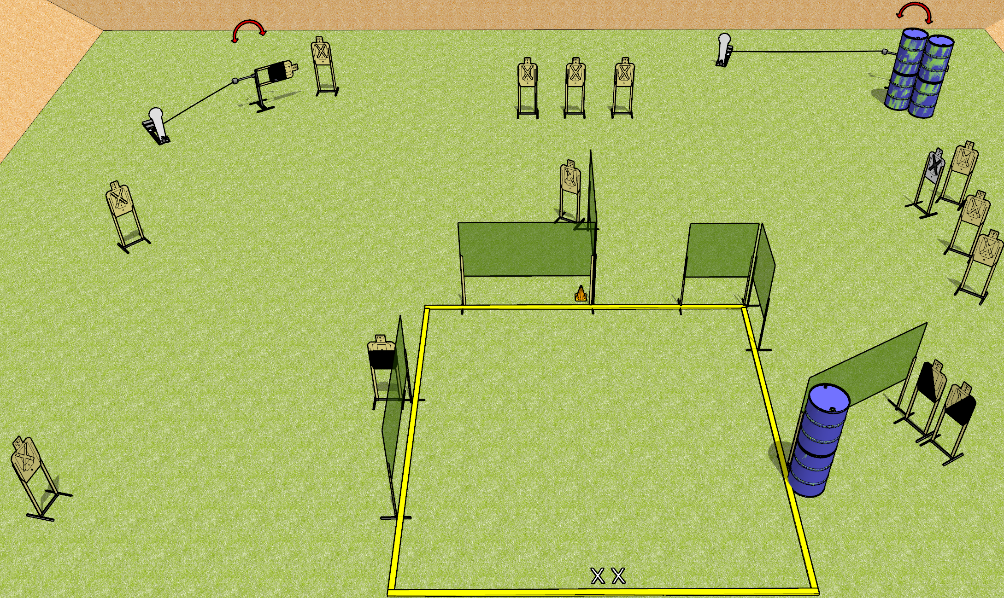
 | Dothan Gun Club – USPSA Match All Squared Up Course Designer : Drew Coleman
START POSITION : Standing with both feet on X’s, wrists below belt
GUN READY CONDITION : Pistol loaded and holstered. PCC loaded, held with both hands, shouldered, safety on, pointed at orange cone. |  | SCORING: Comstock, 32 rounds TARGETS: 15 paper, 2 Steel SCORED HITS: Best 2 on paper, steel until down START-STOP: Audible, last shot RULES:
STAGE PROCEDURE: Engage targets as they become available from within the fault lines.

Slide 2
All Squared Up
Written Stage Briefing
All Squared Up is a 32 round, 160 point, Comstock field course. There are fifteen USPSA targets and two Colt poppers. The best two hits on paper will score, and steel must fall to score. The start signal is audible.
Please check the activators prior to walkthrough and set them up the same way every time.
Handgun start position is standing with both feet on X’s, wrists below belt. Handgun is loaded and holstered.
PCC start position is standing with both feet on X’s, muzzle pointed at orange cone. Loaded carbine is held with both hands, shouldered, safety on.
On start signal engage targets as they become available from within the shooting area.

